Slide 1
Sustainability and inflation
Why do prices rise?
How do rising prices affect sustainability?

Slide 2
What is inflation?
A sustained general rise in prices.

Slide 3
Guesstimate:
How much did prices rise over just four years?
 | Nov. 2010 | Nov. 2014
Toothpaste (100ml) | $1.95 | ?
Peanut butter (500g) | $2.97 | ?
Apples (1 kg) | $3.07 | ?
Bread (675g) | $2.60 | ?
Eggs (dozen) | $2.64 | ?
Chicken (1 kg) | $6.53 | ?
Toilet Paper (4 rolls) | $2.33 | ?
Milk (1 L) | $2.14 | ?
Source: Statistics Canada, CANSIM, table 326-0012

Slide 4
More or less than you thought?
 | Nov. 2010 | Nov. 2014
Toothpaste (100ml) | $1.95 | $2.45
Peanut butter (500g) | $2.97 | $3.48
Apples (1 kg) | $3.07 | $3.74
Bread (675g) | $2.60 | $2.86
Eggs (dozen) | $2.64 | $3.22
Chicken (1 kg) | $6.53 | $7.30
Toilet Paper (4 rolls) | $2.33 | $2.61
Milk (1 L) | $2.14 | $2.34
Source: Statistics Canada, CANSIM, table 326-0012

Slide 5
How do we know prices are changing?
The CPI (consumer price index) tracks changes in retail prices over time.
Statistics Canada surveys citizens to find out which goods/services they regularly purchase.
Approx. 600 of these regularly purchased items are put in a ‘basket of goods’.
Each month Statistics Canada checks prices of the items in the basket of goods and updates the CPI.

Slide 6
Nobody likes paying higher prices, but are rising prices always a bad thing?
No. A certain level of inflation is considered economically healthy – a natural result of economic growth.
The Bank of Canada’s target inflation rate is approximately 2%.
If Canada’s inflation rate is much higher or lower than 2% the Bank of Canada will intervene.

Slide 7
Why do prices rise?
There are two causes of inflation:
Demand-Pull Inflation
Cost-Push Inflation

Slide 8
Demand-Pull Inflation
Aggregate Demand > Aggregate Supply
*Aggregate demand = total demand for all goods and services produced in the economy.
*Aggregate supply = total supply of all goods and services produced in the economy.

Slide 9
Demand-pull inflation occurs when there is too much money in the economy and not enough goods/services, “too many dollars chasing too few goods”.
Increased money supply could be a result of: increased employment levels, low tax rates, low interest rates, increased exports, etc…

Slide 10
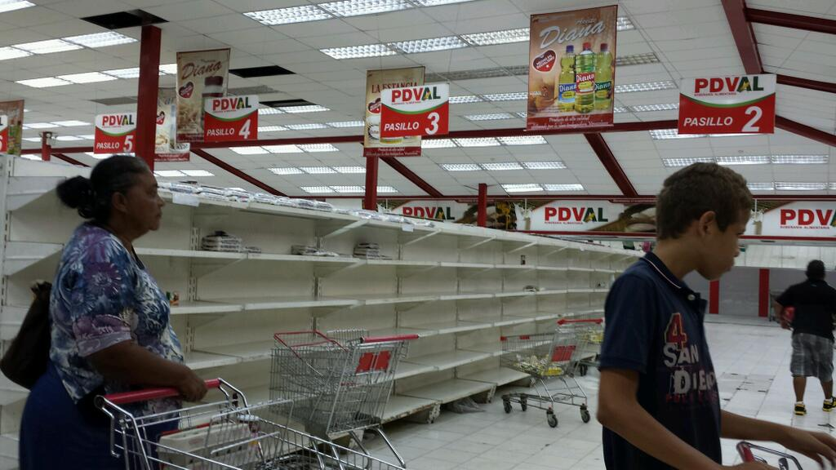
Empty shelves in a Venezuelan store
Source: Forbes, CIPE (2015)

Slide 11
Cost-Push inflation
Results from the passing down of increased production costs from producer to consumer.
Increased production costs could include:
Higher wages for workers, increased cost of raw materials, increased taxes etc...
When production costs rise, producers will increase the retail price paid by consumers to maintain their profits.

Slide 12
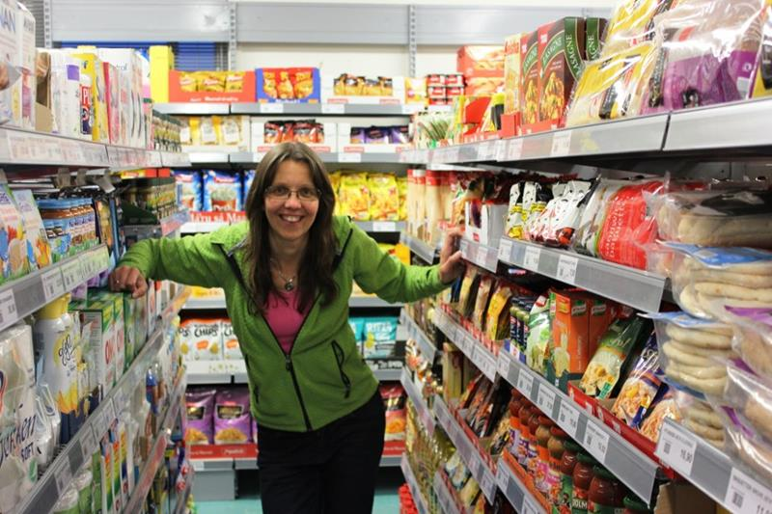
Hellesøy General Store, Norway
Source: www.visitnorway.com

Slide 13
Item | Canada | Norway
Coke/Pepsi (0.33L) | $1.92 | $4.29
Water (0.33L) | $1.68 | $3.79
12 Eggs | $3.28 | $5.07
Chicken breast (1kg) | $12.64 | $17.38
Tomatoes (1kg) | $3.51 | $4.40
McDonalds combo meal | $8.50 | $15.50
Movie (in theatre) | $12.00 | $17.05
1 month rent (city, 1 bdrm) | $1,018 | $1,493
1 month salary (after tax) | $2,987 | $4,019
Source: numbeo.com (2015)

Slide 14
Inflation psychology
People’s expectations of future inflation that leads them to seek larger wage increases and to make purchases of some big-ticket items quickly, before prices rise further.
When many people behave in this way, they actually make inflation more severe.

Slide 15
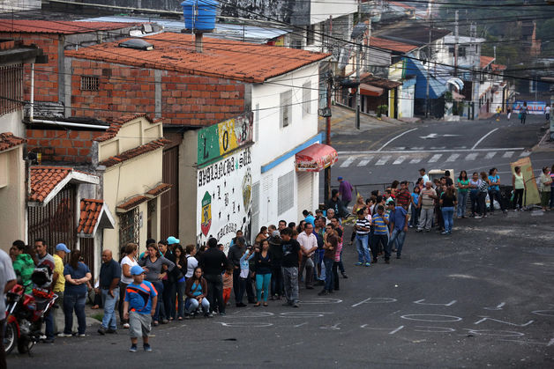
People line up before sunrise to buy basic food products at a supermarket in Venezuela.
Source: Bloomberg, John Moore/Getty Images (2014)
)

Slide 16
Think/pair/share
In your own words, explain the two types of inflation to your seat partner (take turns).
Demand-pull inflation
Cost-push inflation

Slide 17
How can governments control inflation?
A country’s government and its central bank have tools they can use to influence the inflation rate.
Monetary Policy Tools
Fiscal Policy Tools

Slide 18
Monetary policy
Tight monetary policy
If prices are rising too quickly, the central bank can increase the interest rate.
Easy monetary policy
If prices are falling too quickly, the central bank can decrease the interest rate.

Slide 19
The inflation rate rises when there is a lot of money in circulation—a large money supply (a lot of borrowing and spending by consumers and businesses).
Increasing the interest rate discourages borrowing and spending because interest is the cost of borrowing. Consumers and businesses do not like high interest rates because it means they have to pay back more money.
*Vice versa for lowered interest rates.

Slide 20
High interest rates decrease aggregate demand and therefore decrease the inflation rate.
Low interest rates increase aggregate demand and therefore increase the inflation rate.

Slide 21
Think/pair/share
Why is the relationship between the interest rate and the inflation rate described as inverse
(when one goes up, the other goes down)?

Slide 22
Fiscal policy
Contractionary fiscal policy
If prices are rising too quickly, the government can decrease spending and increase taxation.
Expansionary fiscal policy
If prices are falling too quickly, the government can increase spending and decrease taxation.

Slide 23
If the government decreases spending there will be budget cuts and fewer projects initiated (resulting in job loss and decreased business profits), as well as a decrease in transfer payments (i.e. reduced welfare rates).
Increased unemployment, lowered business profits, and smaller transfer payments, decrease aggregate demand because they result in less spending by consumers and businesses. Decreased aggregate demand lowers the inflation rate.
*Vice versa for expansionary fiscal policy.

Slide 24
Think/pair/share
Why would a contractionary policy decrease the inflation rate and expansionary policy increase it?

Slide 25
Why should YOU care?
Why is it important that prices remain stable?
How does price stability impact the social, economic, and environmental sustainability of a country?

